Slide 1

Domain: Deep Learning Technology: Python
DETECTING DIABETIC RETINOPATHY USING DEEP LEARNING

Slide 2
INDEX
ABSTRACT
INTRODUCTION
LITERATURE REVIEW
EXISTING METHOD
PROPOSED SYSTEM
BLOCK DIAGRAM
ARCHITECTURE
SYSTEM SPECIFICATIONS
SYSTEM DESIGN
RESULTS
CONCLUSION
REFRENCES

Slide 3
ABSTRACT
Diabetic Retinopathy (DR) is a human eye disease that occurs in diabetics and causes retinal damage, which can lead to blindness in the long run. DR is currently being manually screened by ophthalmologists, which is a time-consuming procedure. And from now on, this task (project) will concentrate on analyzing various DR stages using Deep Learning (DL), a subset of Artificial Intelligence (AI). We trained a model called MobileNet on a massive dataset of 3662 train images to detect the DR stage and classify them into high resolution fundus images. Kaggle hosts the dataset that we are using (APTOS). There are five DR stages: zero, one, two, three, and four.
In this paper, fundus eye images from patients are used as input parameters. A trained model will then extract features from fundus images of the eye, and an activation function will provide the output. This architecture detected DR with an accuracy of 0.9611 (quadratic weighted kappa score of 0.8981). Finally, we compare the two MobileNet architectures.

Slide 4
INTRODUCTION
DR is the most debilitating form of diabetes in which serious damage occurs to the retina and causes visual impairments. It harms the veins inside the retinal tissue, making them spill fluid and contort vision. Alongside maladies prompting visual impairment like, waterfalls and glaucoma, DR is one of the most continuous diseases. There are five stages of DR that is 0, 1, 2, 3, and 4. The below table gives the overall details about DR Each stages has its own symptoms and specific properties, now from normal images doctors can not specify the DR stages. Moreover existing methods for diagnosing are very inefficient because it takes very large time, due to which the treatment may go the wrong way.
To detect retino-pathy doctors used fundus camera which takes the picture of veins and nerves which is behind the retina. The initial phase of this disease has no signs of DR, so it turns into a real challenge to recognize it into a starting stage. For early detection we have used the different

Slide 5
MobileNet algorithms, so that doctors can start the treatment at the correct time. In this paper the dataset which we are using for the project is collected from “Aravind Eye Hospital” and it is available on Kaggle that is “APTOS (Asia Pacific TeleOphthalmology Society)”. We compare the two MobileNet architectures and showing the results of these two architectures. In recent projects and researches, AI models, and in AI specially “Deep Learning” gives the most accurate outputs in finding hidden layers in various AI tasks, particularly in the field of medical image analysis. Based on the deep learning models which are classify diseases and support medical decision making and can improve the persistent consideration (extra care).

Slide 6
LITERATURE REVIEW
S. No | Journal Type with year | Authors | Title | Outcomes
1 | MDPI, 2017 | Kele Xu, Dawei Feng, and Haibo Mi | Deep Convolutional Neural Network-Based Early Automated Detection of Diabetic Retinopathy Using Fundus Image | In this paper, we explored the use of deep convolutional neural network methodology for the automatic classification of diabetic retinopathy using color fundus image, and obtained good accuracy on our dataset, outperforming the results obtained by using classical approaches.
2 | AMIA, 2018 | Lam C, Yi D, Guo M, Lindsey T | Automated Detection of Diabetic Retinopathy using Deep Learning | In this paper, we demonstrate the use of convolutional neural networks (CNNs) on color fundus images for the recognition task of diabetic retinopathy staging.
3 | JAMA, 2016 | Varun Gulshan, Subhashini Venugopalan, Rajiv Raman | Development and Validation of a Deep Learning Algorithm for Detection of Diabetic Retinopathy in Retinal Fundus Photographs | The algorithm was evaluated at 2 operating points selected from the development set, one selected for high specificity and another for high sensitivity.
4 | ISSPIT, 2019 | Sara Hosseinzadeh Kassani, Peyman Hosseinzadeh Kassani, Reza Khazaeinezhad, Michal J. Wesolowski et al | Diabetic Retinopathy Classification Using a Modified Xception Architecture | In this paper, we present a new feature extraction method using a modified Xception architecture for the diagnosis of DR disease.

Slide 7
EXISTING METHOD
This model emphasizes an existing method that which is designed using the some of the algorithms of machine learning. Here the process is performed using the ANN, which is one of the transfer learning methods, but this could not get the high accuracy.
DRAW BACKS:
Less feature compatibility
Low accuracy

Slide 8
PROPOSED SYSTEM
In purposed method we are performing the classification of either the diabetic retinopathy identification using MobileNet of deep learning along with the machine learning methods. As image analysis based approaches for diabetic retinopathy detection. Hence, proper classification is important for the proper retinopathy that which will be possible by using our proposed method. Block diagram of proposed method is shown below.
ADVANTAGES:
Accurate classification
Less complexity
High performance
Easy identification

Slide 9
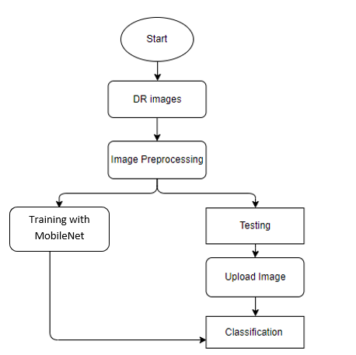
BLOCK DIAGRAM

Slide 10
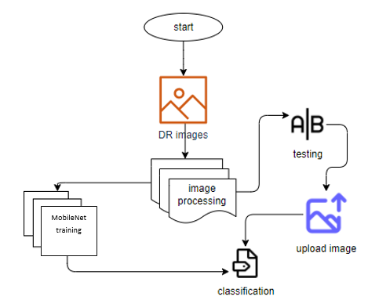
ARCHITECTURE

Slide 11
Thank You

